Slide 1
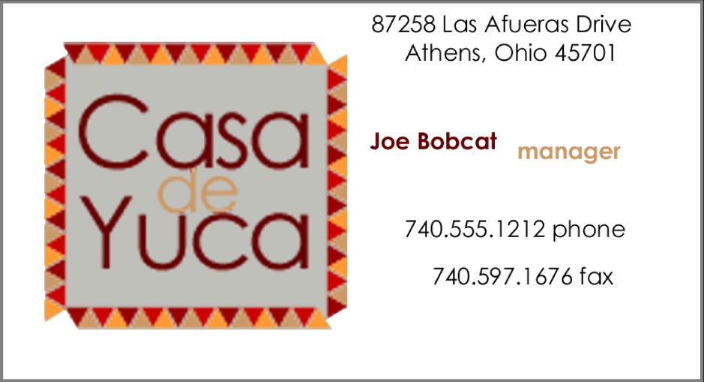
CASE -1
Analyze this design
Complete the table with the problems you have found
Proximity | Yes because have partition group
Alignment | No because hard to look at.
Contrast | Yes because it have logo and big letters in that logo .and color
Repetition | Yes because around border have the same color.

Slide 2
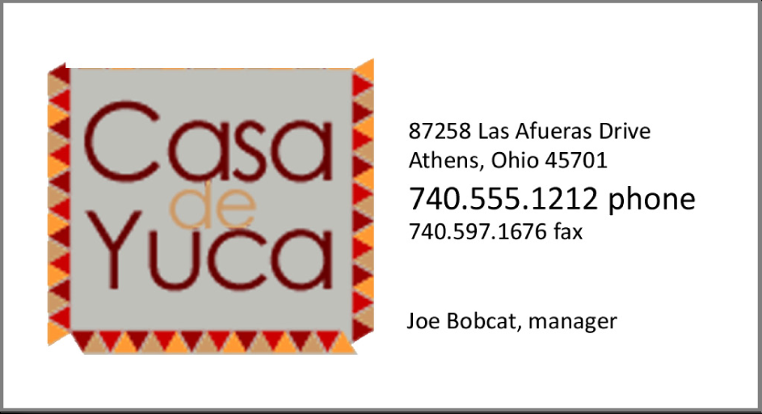
CASE -2
Analyze this design
Complete the table with the problems you have found
Proximity | Yes because it have group and have space
Alignment | Yes because it have alignment left
Contrast | no because it
Repetition | Yes it have font letter same

Slide 3
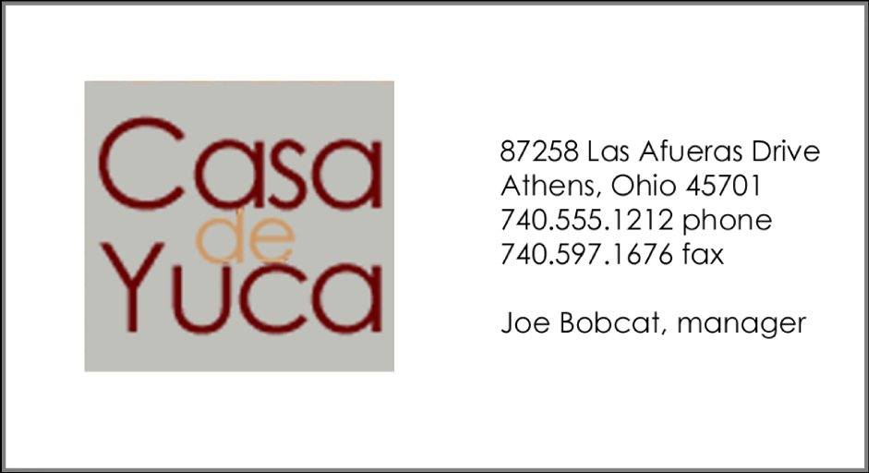
CASE -4
Analyze this design
Complete the table with the problems you have found
Proximity | Yes . It have group
Alignment | Yes it have alignment left
Contrast | Yes logo
Repetition | Yes because it have same font letter

Slide 4
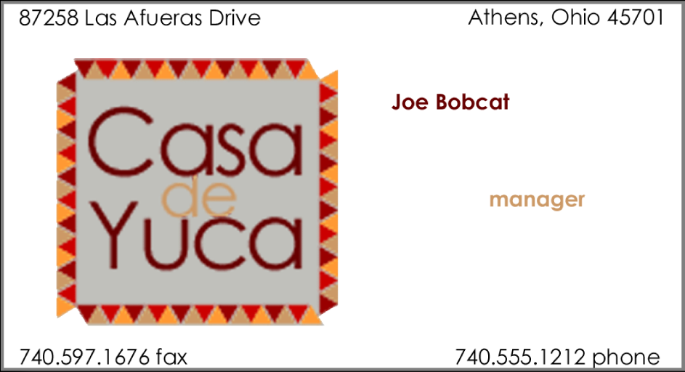
CASE -3
Analyze this design
Complete the table with the problems you have found
Proximity | No it alone
Alignment | No it haven’t
Contrast | Yes it have color on the name and manager
Repetition | Yes the border have same and font letter is same too.

